Slide 1
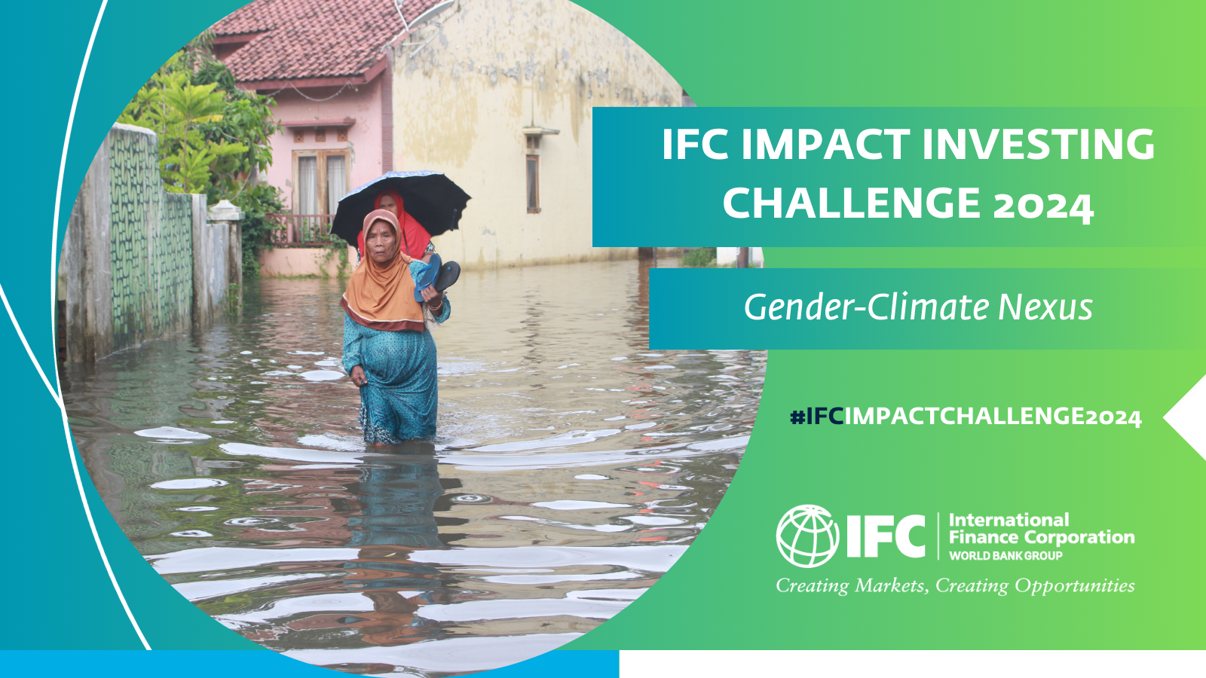
Team Name
University Name
IMPACT INVESTING CHALLENGE 2024

Slide 2
Team Name
Member #1
Degree/Course [Optional – other info]
Member #2
Degree/Course [Optional – other info]
Member #3
Degree/Course [Optional – other info]

Slide 3
The Challenge
Please describe the area of focus within the gender-climate nexus that your team is addressing with the investment proposal
If applicable, please include the necessary context information such as country/region, sector, market gaps, target group, etc.

Slide 4
The Solution
Provide an overview of the investment proposal, highlighting the investment target, business model, investment structure, how the investment addresses the challenge you identified, and other factors to consider

Slide 5
Feasibility and Implementation
Provide a high-level overview of the implementation plan that demonstrates the commercial viability of the proposal, including details related to capacity-building or other support needed for your solution
Mention any key limitations or risks associated with the implementation plan
Comment on how the investment helps the client achieve sustainability in terms of operations or financing and how this investment could help mobilize private capital for development financing
Note: Quantitative analysis can support the proposal, although detailed modeling is not required

Slide 6
Impact and Innovation
Identify key beneficiaries and how you would measure the impact on these end beneficiaries (to learn more about how IFC assesses its impact, click here)
Highlight how your solution advances gender-inclusive climate finance
Highlight the innovation in the proposed investment opportunity, including comments on how this model could be scaled up and replicated across different geographies or sectors

